Slide 1
‘Healer’
Tanvir Ahmed
(193-35-491)
“Healer is a psychological consultancy platform that based on human brain and psychology and mindfulness techniques”

Slide 2
Solution & Planning
In there will be two panel:
1.System Admin 2.User
The functionalities will be:
1. Patient and Psychologist user profiles.
2. Enabling the patients to view psychologist qualification details.
3. Enabling the patients to view psychologist availabilty.
4. Enabling live sessions and events.
5. Rating and review and comments section.
6. Event and counseling notifications.
7. Blog , articles & books.
8. Payment via bkash,nagad,credit card etc.
9. Location based functionality .

Slide 3

Scope
To increase their well-being and quality of life.
Easy to way your psychological consultation.
That much be easier to your tight schedule life for some relaxing time and helps to solve your some digaster problems.

Slide 4

Assumption & Constraints
lackins of English & Bangla skill will face difficulty in using the system.
Login and password is used for identification of user and there is no facility for guest.

Slide 5
Dependencies & Risk
Main risk behind implementing the project is design.
Another concern is having common bugs such as the common users are having the same functionalities.

Slide 6
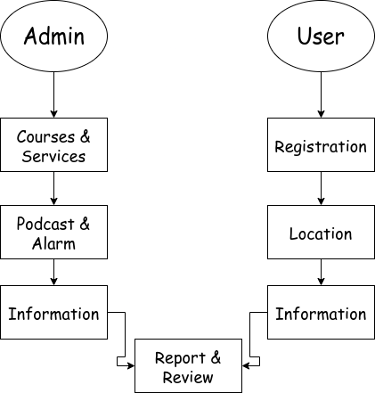
Flow Chart
Healer

Slide 7
System
Front End HTML CSS JS
React
Backend Python Django
Database SQL

Slide 8
RESOURCES
Online URL:
https://www.verywellmind.com/psychology-4014660
https://www.medicalnewstoday.com/articles/154874
https://www.ox.ac.uk/admissions/undergraduate/courses/course-listing/psychology-experimental

Slide 9

THANKS
Do you have any questions?
tanvir35-491@diu.edu.bd
+8801984421981

